Slide 1
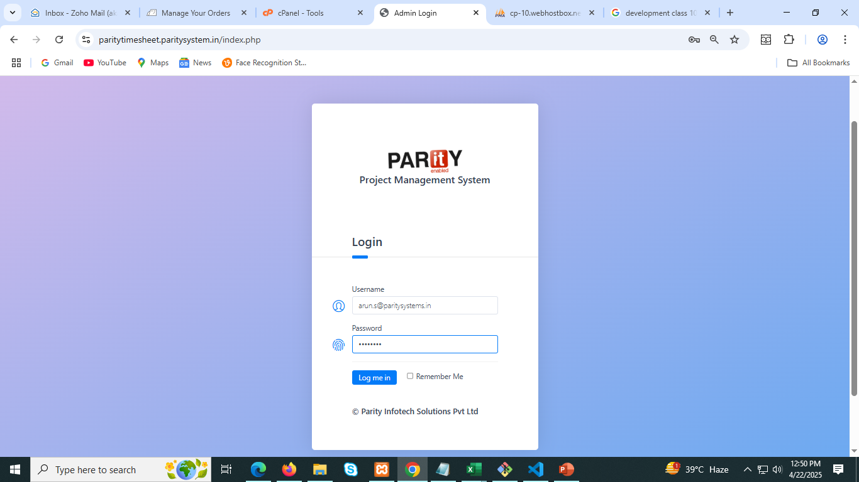
Login Page

Slide 2
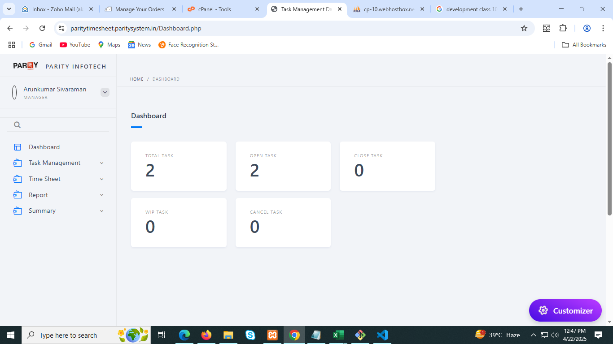
Step 1 : Here we logged in as the manager, so the Manager Dashboard is being displayed.

Slide 3
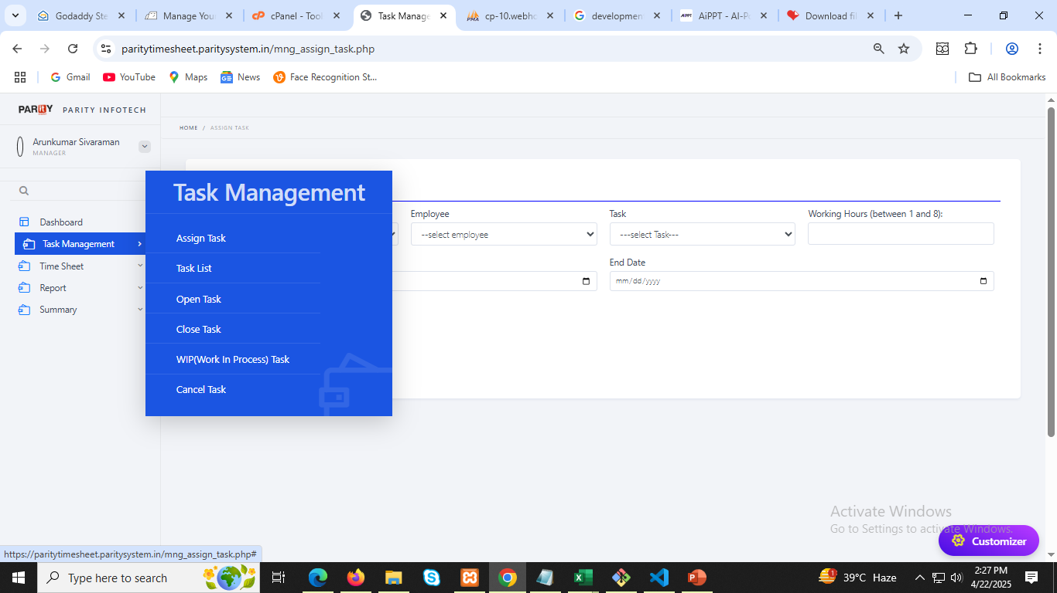
Step 2 (a): Click on Assign Task When you click on Assign Task, you will be able to assign tasks to your client/employee.

Slide 4
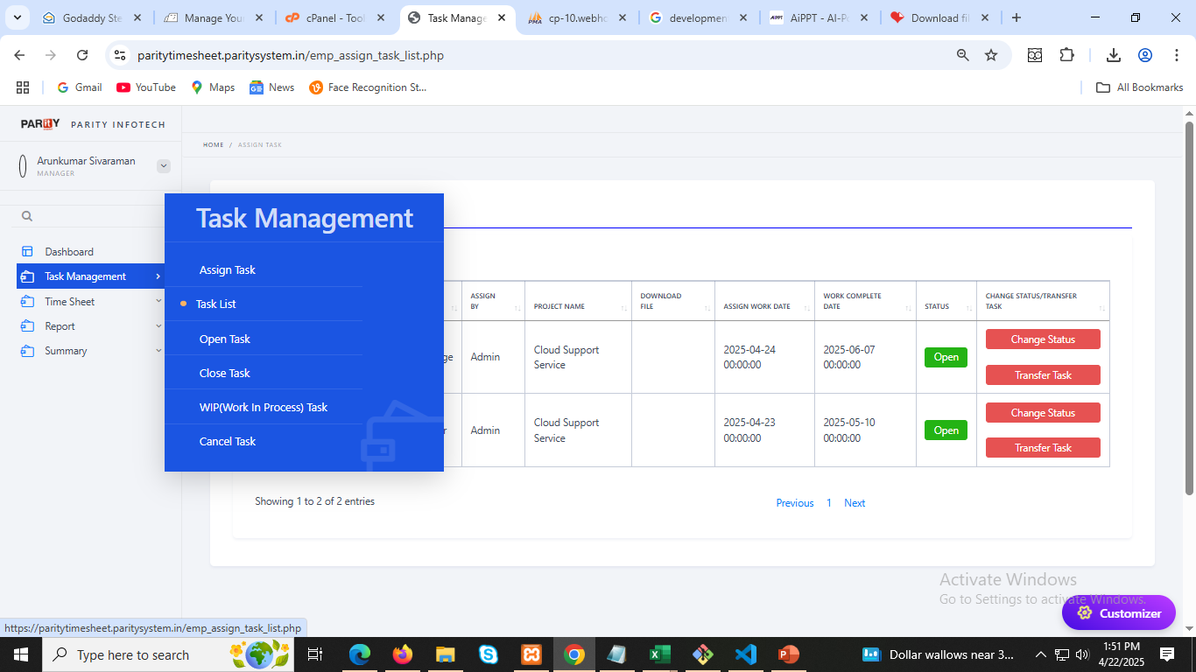
2(b) : Click on Task List and you can see all task assign by manager as show below .

Slide 5
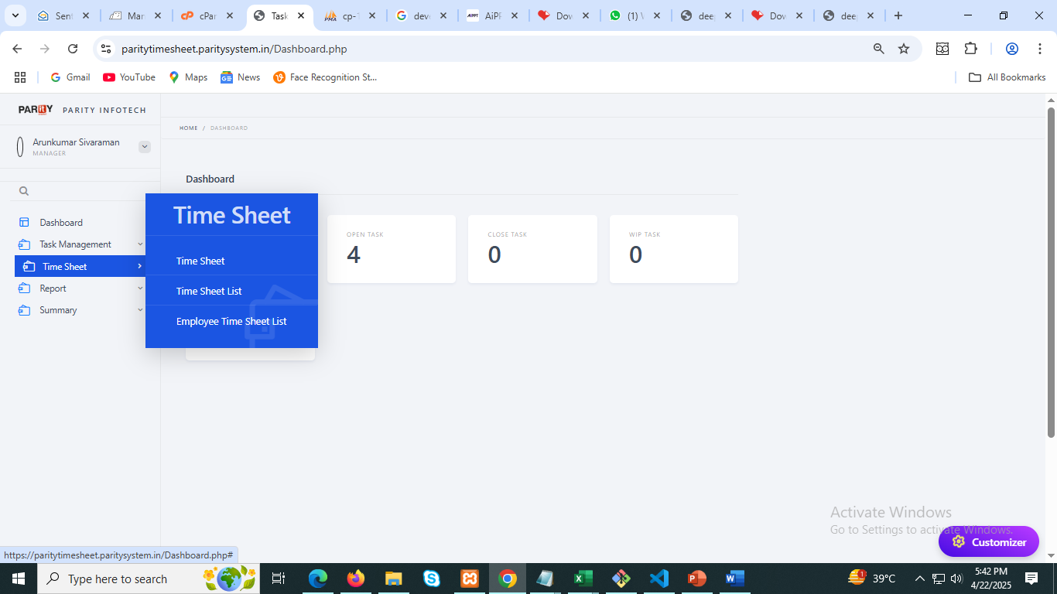
Step 3 : Click on Timesheet Management option Three options are available here: Timesheet, View Timesheet, and Employee Timesheet.

Slide 6
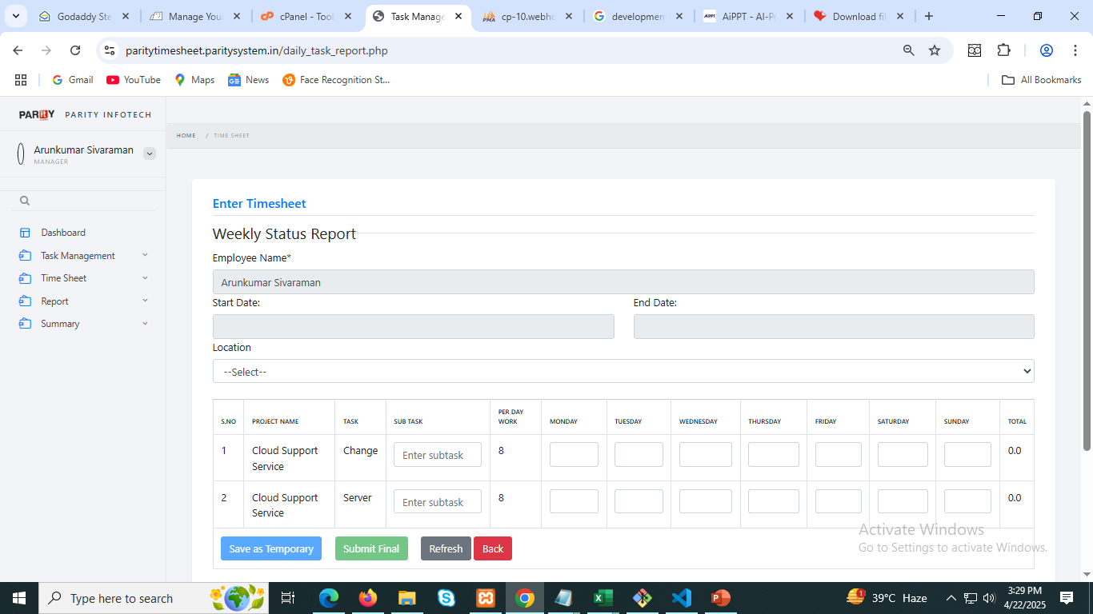
3 (a) : Click on Timesheet option When you click on Timesheet, you can fill in your weekly project and other task timesheets from here.

Slide 7
We have two options to save our timesheet:
Save as Temporary – In this option, the timesheet is saved temporarily and remains with us.
Submit Final – In this option, the final timesheet is submitted and saved with the manager.
If the manager disapproves the timesheet, it becomes editable, and we can update and resubmit it to the manager.
However, if the manager approves the timesheet, it cannot be changed anymore.
One important thing to keep in mind while filling the timesheet is:
Every column must have a value — if there is no entry, then you must fill it with 0.Otherwise, the timesheet will not be saved.

Slide 8
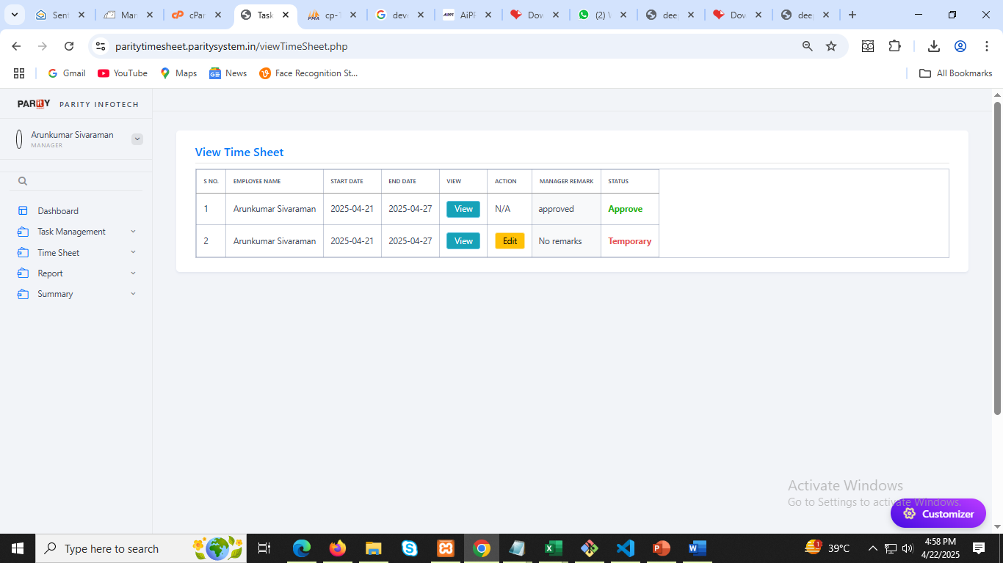
3(b) : Click on View Timesheet List option When we click on View Timesheet, we can see our approved timesheets (approved by the manager) as well as temporary timesheets that we have saved. We can also edit the temporary timesheets.

Slide 9
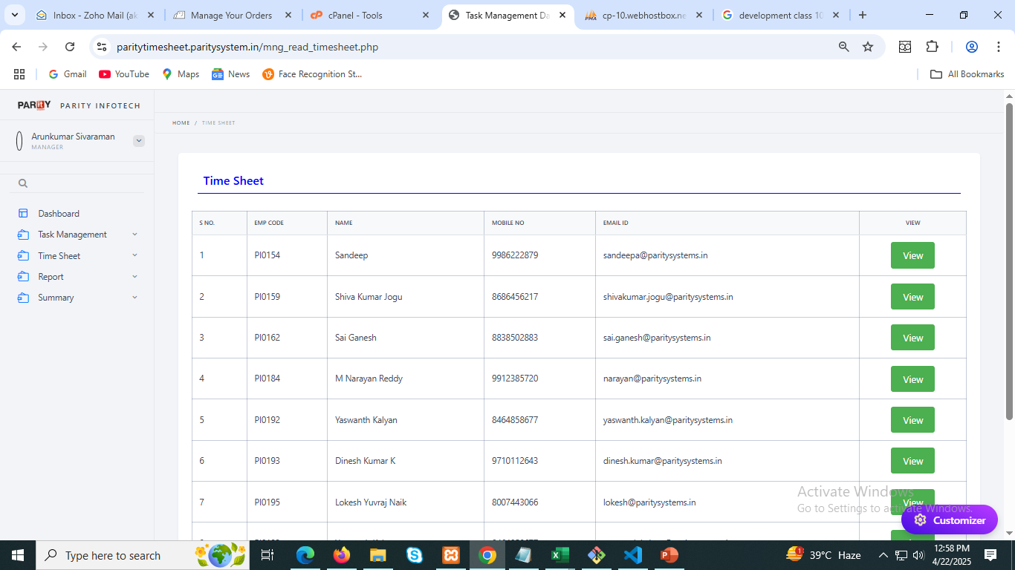
3(c) : Click on Employee Timesheet List option Here, you can view the timesheets of all employees who are under the manager.

Slide 10
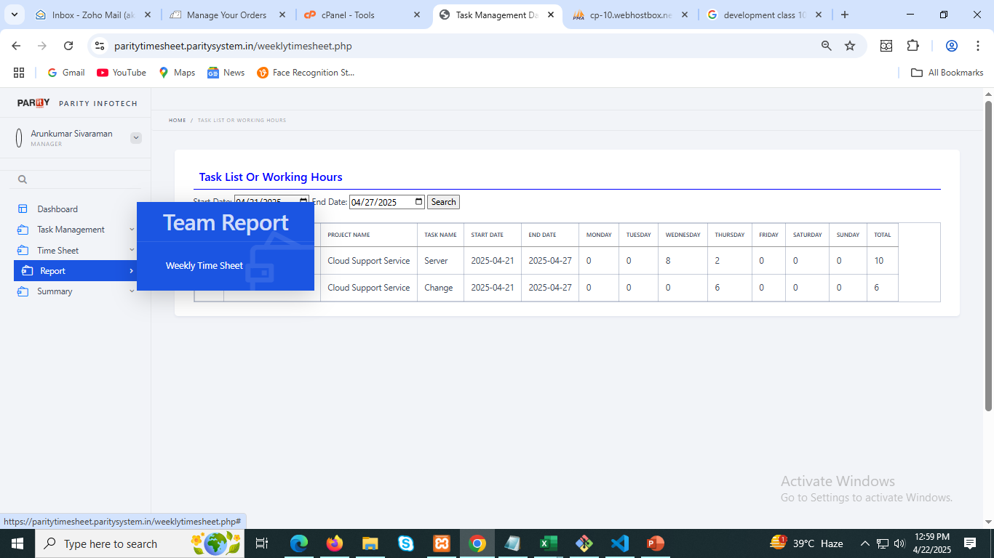
Step 4 : Click on Report Option When we click on Report, the timesheets of all employees/clients under the manager will be displayed according to the selected start date and end date.

Slide 11
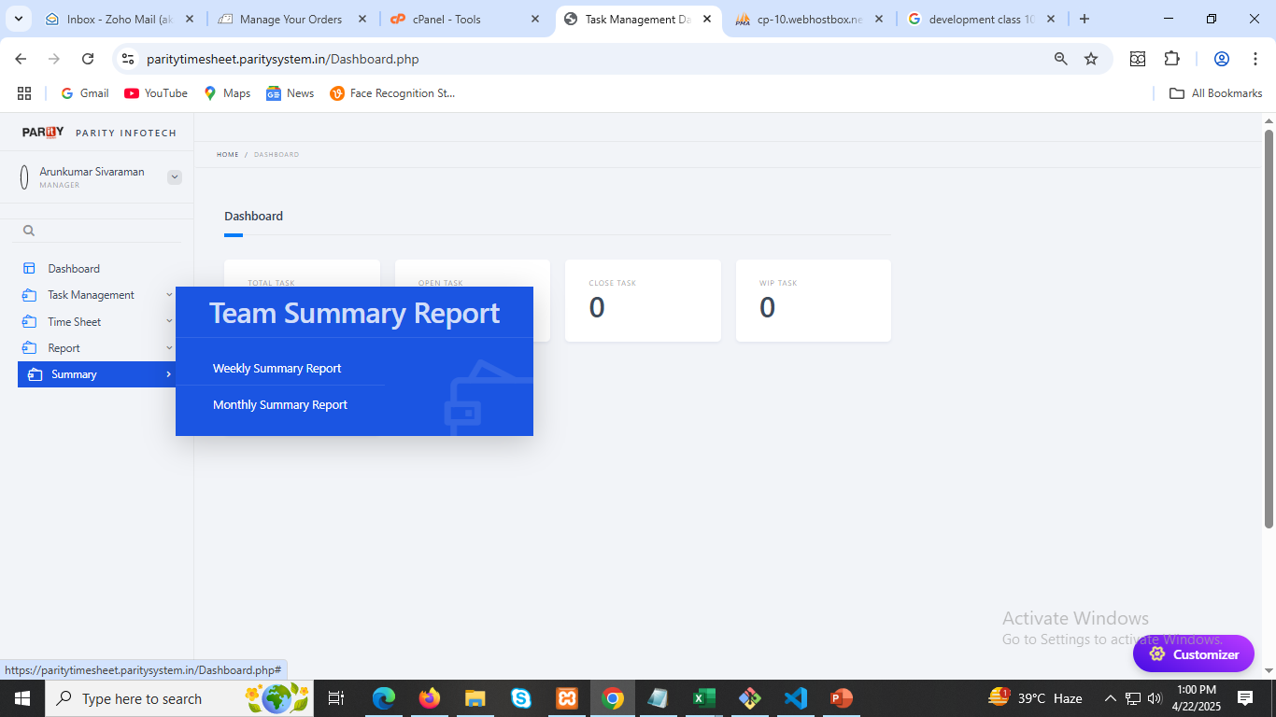
Step 5 : Click on Summary Option Here, you can view the weekly summary report of all employees as well as their monthly summary report .

Slide 12
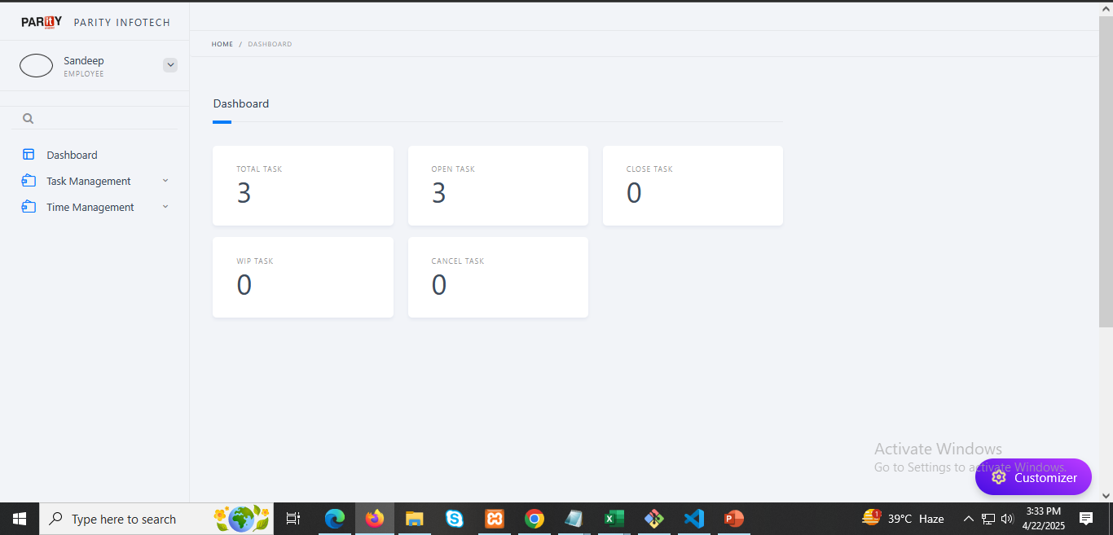
Logged in as an employee Step 1 : Employee Dashboard

Slide 13
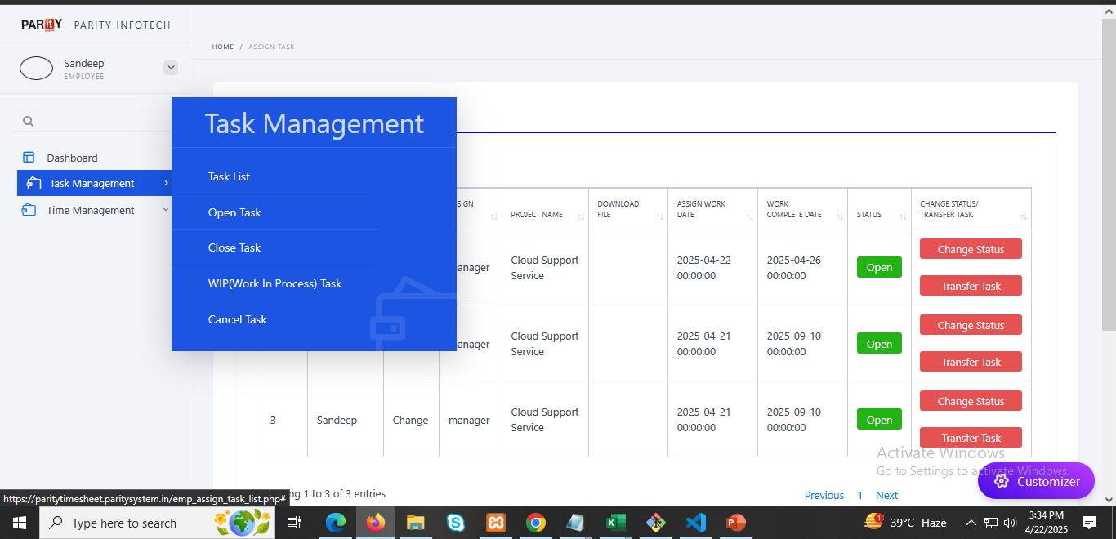
Step 2 : Click on Task List and can see all task assign by manager as show below .

Slide 14
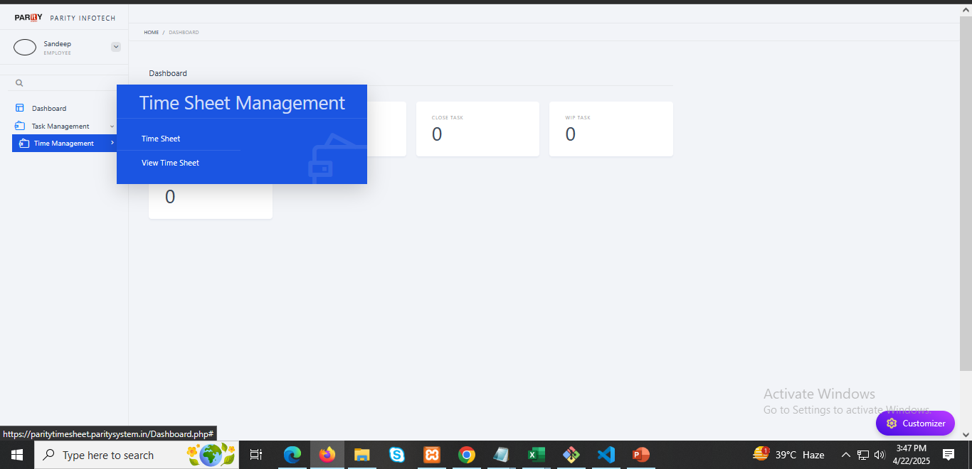
Step 3 : Click on Timesheet Management option

Slide 15
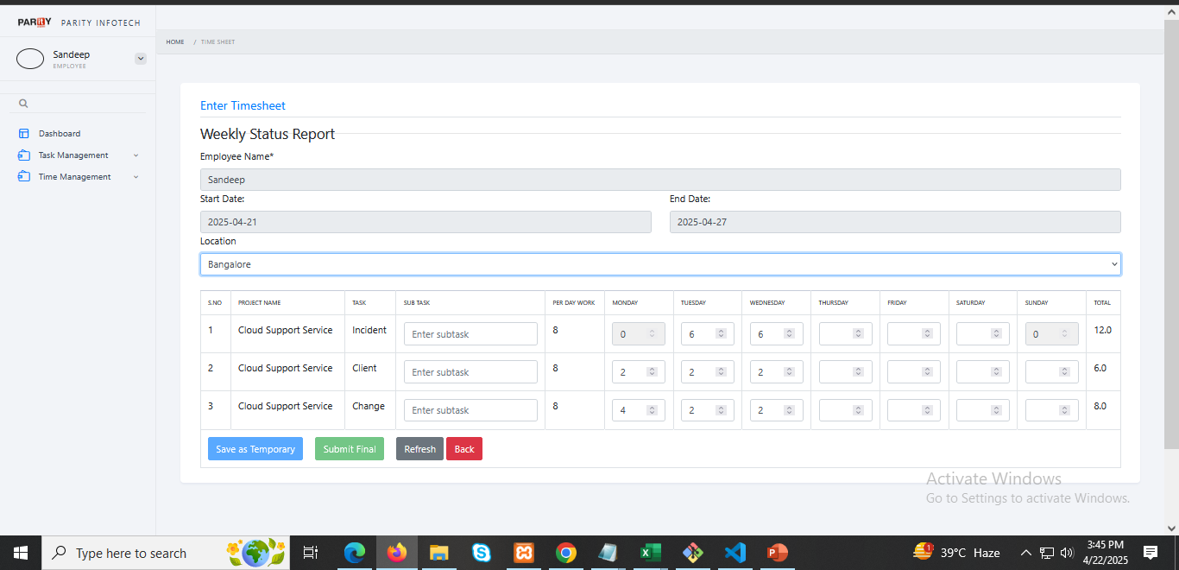
3 (a) : Click on Timesheet option When you click on Timesheet, you can fill in your weekly project and other task timesheets from here.

Slide 16
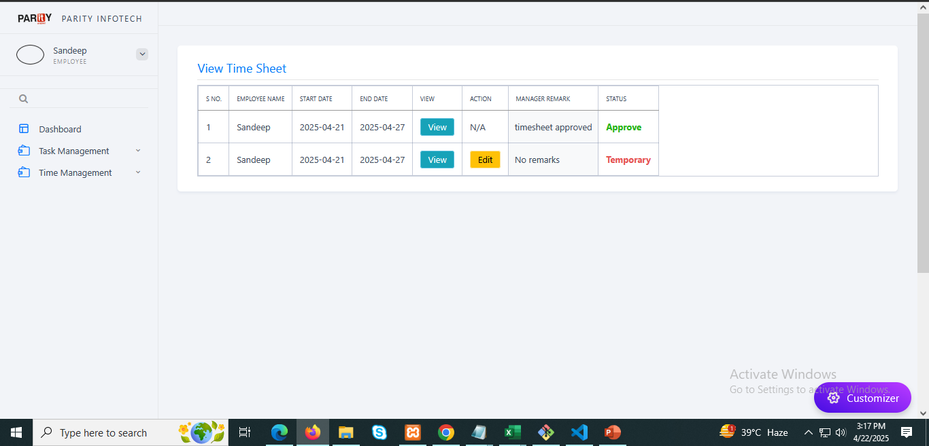
3 (b) : Click on View Timesheet option Here, when you click on View Timesheet, you can see the timesheets you have temporarily saved for yourself, as well as the ones you have finally submitted and that have been approved by the manager.

Slide 17
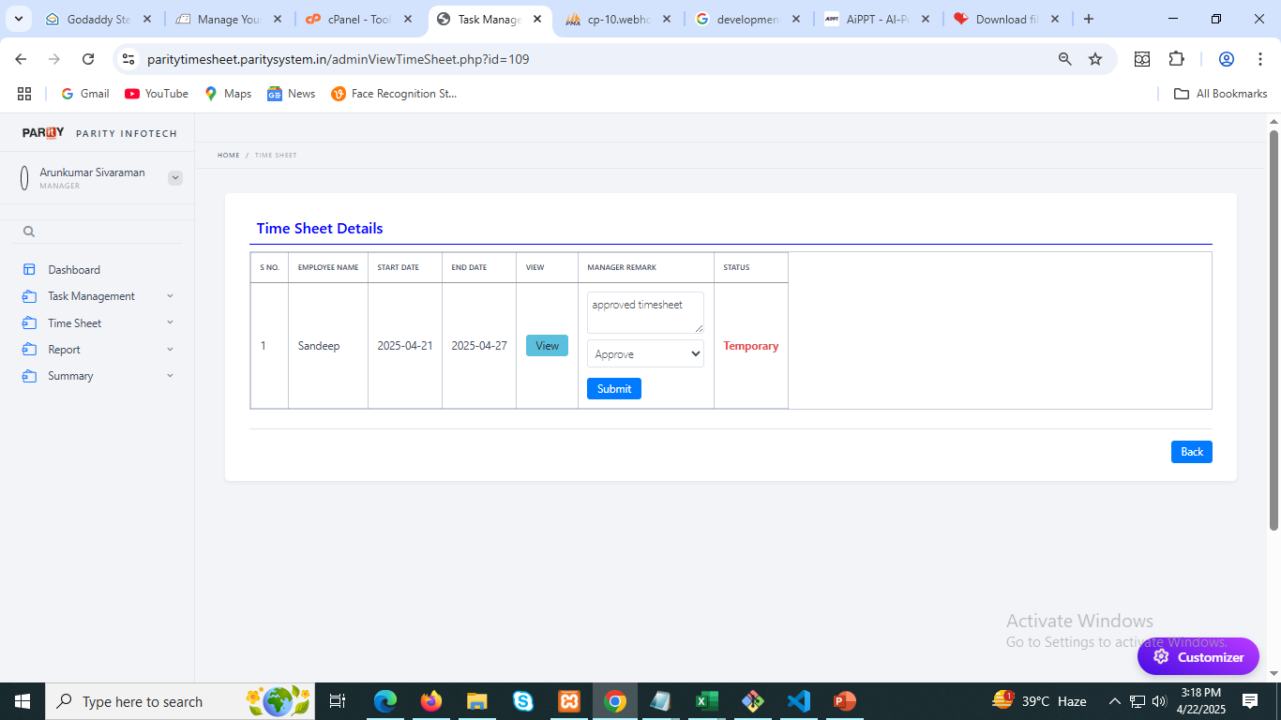
NOTE : Here, you can see that when an employee submits their temporary or final timesheet to the manager, the manager can view it and give approval accordingly and If the manager disapproves the timesheet here, they can add a remark, and the employee will be able to edit the timesheet.

